Slide 1

7 Revealing Ways AIs FAIL
Presenter: Shahzad Momayez
Winter 1403

Slide 2
In The Name of God

Slide 3
Table of Contents
Introduction
00
01
Brittleness
02
Embedded Bias
03
Catastrophic Forgetting

Slide 4

Table of Contents
04
Explainability
05
Quantifying Uncertainty
06
Common Sense
07
Math
08
Conclusion

Slide 5
Introduction
The article explores seven critical weaknesses of artificial intelligence (AI), emphasizing their real-world implications and potential remedies.

Slide 6
Artificial intelligence (AI) is changing the world by solving problems faster, more accurately, and more reliably than humans.
It’s used for tasks like:
Detecting diseases
Helping in hiring decisions
Driving cars
…
But AI is far from perfect. It has serious flaws. AI fails is important so we can fix these issues and build better, more trustworthy systems.
This article explains seven major ways AI fails and what we are doing to address these problems.

Slide 7
What are these 7 flaws of the AIs?

Slide 8
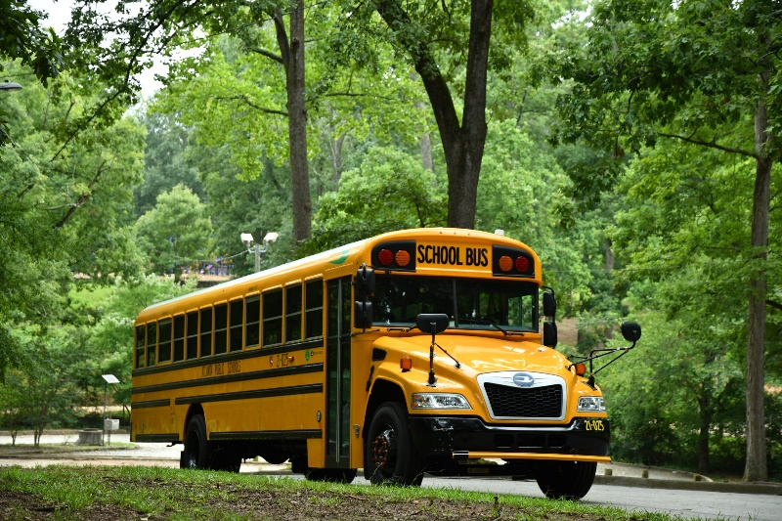

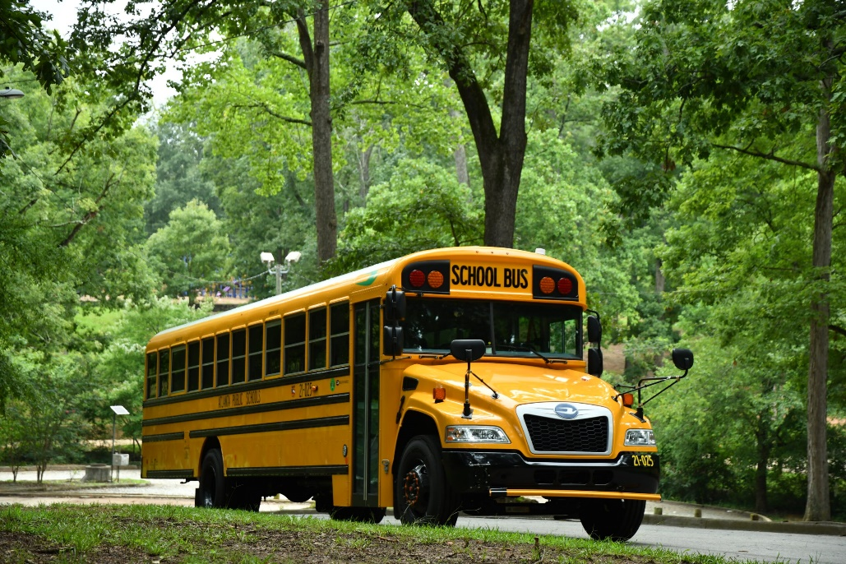
Brittleness
01
Flipped
AI systems often fail when faced with situations they haven’t been trained for.
For example, an AI that could recognize a school bus struggled when the image of the bus was flipped on its side and it misidentified it as a snowplow.
Even small changes, like putting stickers on stop signs or changing a single pixel in an image, can confuse AI.
This happens because AI can only recognize patterns it has seen before.
What is the label of this picture?
Snowplow
School Bus

Slide 9
Remedies:
To make AI stronger, researchers train it using “adversarial examples” which are tricky scenarios designed to confuse the system. This helps AI learn to handle unexpected changes. However, rare, unpredictable events (like pandemics or natural disasters) still pose a challenge, even for humans.

Slide 10
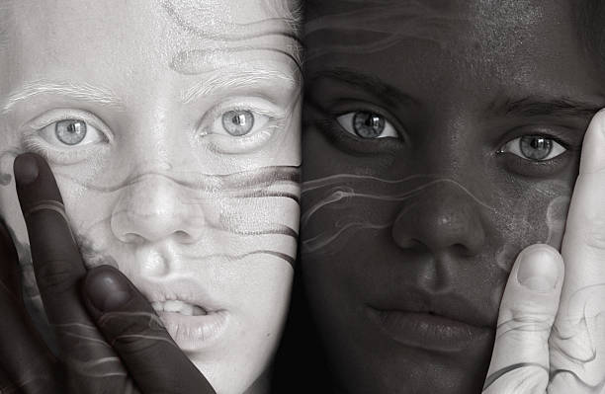
Embedded Bias
02
AI can pick up and amplify biases present in its training data.
For instance, a healthcare AI prioritized healthier white patients over sicker Black patients because it assumed higher medical costs meant more severe illness. This overlooked systemic inequalities in healthcare access.

Slide 11
Remedies:
Researchers suggest retraining AI with better datasets that represent all groups fairly. Regularly testing the AI for biased behavior and having oversight teams monitor its decisions can also help.
Developing algorithms that focus on fairness and transparency is another effective solution.

Slide 12
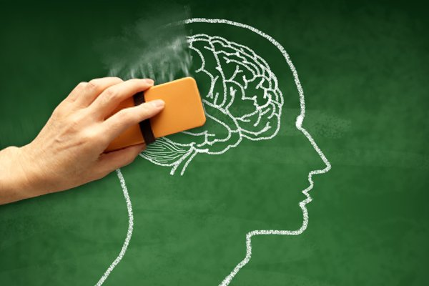
Catastrophic Forgetting
03
AI tends to forget what it learned previously when it’s trained on new tasks.
For example, an AI detecting fakes stopped recognizing older types of fake videos after being updated to identify new ones.

Slide 13
Remedies:
One solution is “knowledge distillation”. It means that older AI systems pass their knowledge to newer ones.
Another approach involves periodically refreshing the AI with summaries of old data.
Researchers are also developing continuous learning techniques that allow AI to retain knowledge without relying on private or outdated data.

Slide 14

04
Explainability
AI decisions often feel like a “black box”. It means that people don’t know why or how an AI made a particular decision.
For example, it’s hard to understand why an AI suspects someone has cancer or predicts a criminal risk score.

Slide 15
Remedies:
Researchers are creating tools to explain AI decisions in simple, clear ways. One idea is to build databases of correct explanations that AI can reference.
Another approach is to develop standardized methods that make AI behavior more predictable and consistent.

Slide 16
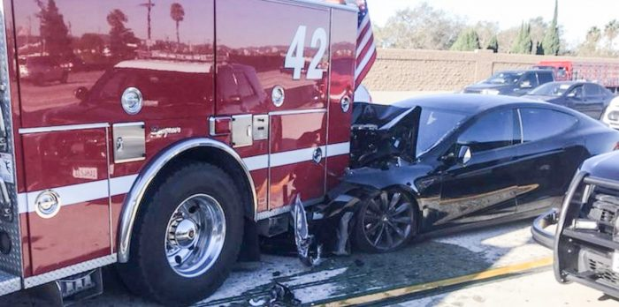
05
Quantifying Uncertainty
AI can act overconfident even when it’s wrong.
For instance, in 2016, a Tesla autopilot system failed to recognize a truck and caused a fatal crash. It didn’t realize it was uncertain about the situation.

Slide 17
Remedies:
AI systems can be improved to measure their own uncertainty and alert humans when unsure.
For example, some AI systems in healthcare now indicate confidence levels for diagnoses, which helps doctors make better decisions.
Researchers are working on faster techniques to apply this idea in real-time systems like self-driving cars.

Slide 18
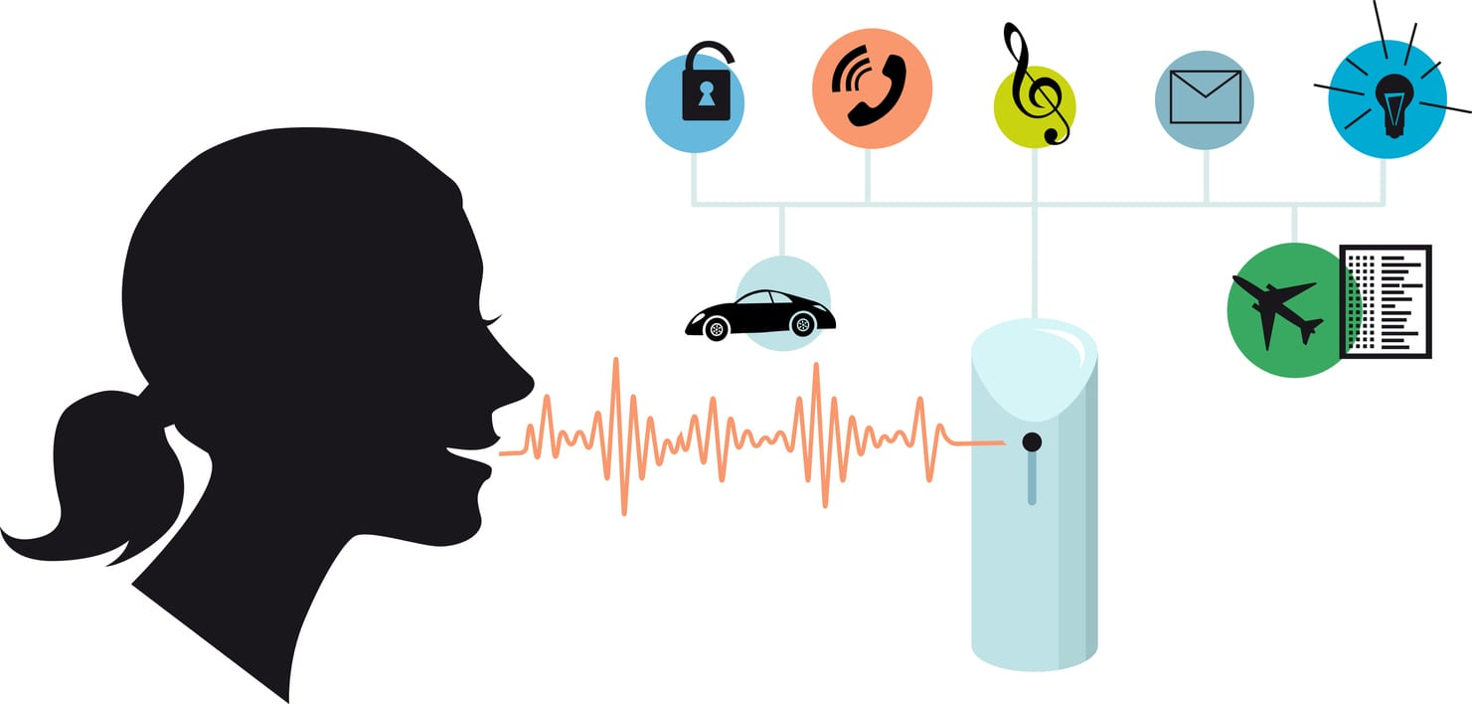
06
Common Sense
AI lacks common sense, which means it often fails to understand context.
For example, hate speech detection systems can mistakenly label harmless phrases as offensive because they don’t grasp the intent or tone behind the words.
.

Slide 19
Remedies:
To improve AI’s common sense, researchers are training it using more realistic datasets and testing it with comprehensive checklists that include diverse situations. This helps AI understand context better and avoid making illogical decisions

Slide 20
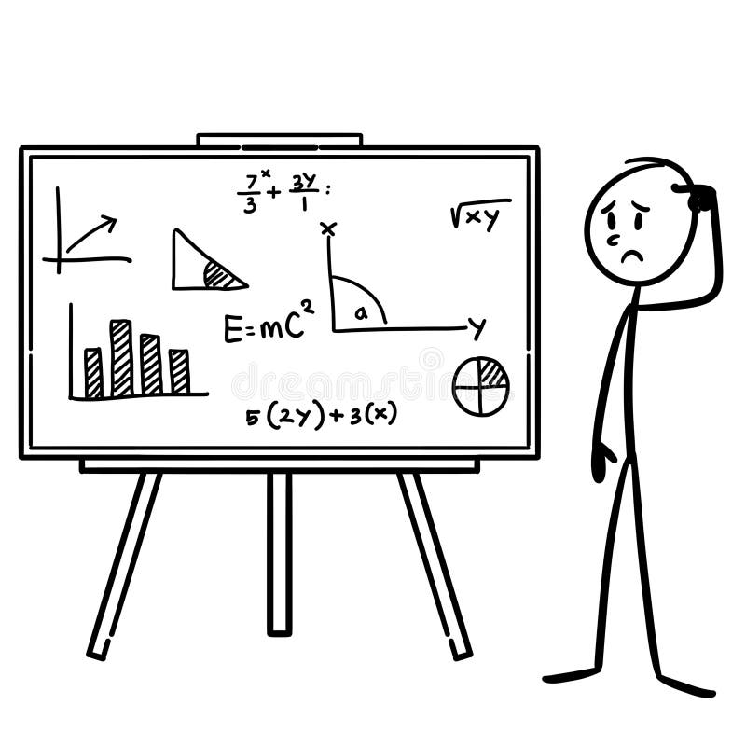
07
Math
Despite their advanced capabilities, AI systems are surprisingly bad at solving math problems. Even state-of-the-art models struggle with high school math, achieving low accuracy. This is because AI processes data in a parallel way, while math requires step-by-step reasoning.

Slide 21
Remedies:
Researchers are exploring new AI architectures that are better suited for sequential problem-solving. Providing AI with more structured math datasets.
Teaching AIs how to break down problems into smaller steps can also help improve their performance.

Slide 22
Conclusion
AI has immense potential to improve our lives, but it’s not without flaws. From brittleness and bias to a lack of common sense and transparency, these failures show us where AI needs improvement.
Thankfully, researchers are working hard to address these challenges with creative solutions, like better training methods, fairer algorithms, and smarter systems.
By understanding these weaknesses and their remedies, we can build AI that is not only more reliable but also safer and fairer for everyone.

Slide 23
Reference
Choi, C. Q. (2021, October). 7 revealing ways AIs fail. IEEE Spectrum. Retrieved from https://spectrum.ieee.org

Slide 24
Thank You for Your Attention

